Slide 1
Continuity in Arc Connections
For the Geometry Library
2024-06-29 by S. Brennan

Slide 2
There are 3 types of continuity commonly used on roads
C0 –arcs connect at ends
C1 – arcs are tangent to each other, connected by line segments e.g. slope continuity
C2 – arcs connect by spirals, e.g. curvature continuity

Slide 3
This presentation will show that the requirements for continuity are related to the radii, r1 and r2, and signed distance between the centers of circles 1 and 2, d12
These conditions have geometric meaning in plots of r2 versus d12

Slide 4
We define the signed distance from 1 to 2, d12, as the center-to-center distance between a starting circle (green) and ending circle (red).
Start, 1
End, 2
End, 2
Start, 1
Positive d12
Negative d12
Note that circles both are counter-clockwise in the arc direction (CCW). The sign (+ or -) of d1s, discussed in the next slides, depends on the direction of the arcs around the circle and the points of departure from circle 1 to circle 2.

Slide 5
The sign is necessary because there are often several possible continuity solutions, but only one will be valid
Examine the vectors from the center of circle1 (c1) to the valid departure point (d1) on circle1, Vc1d1. Similarly, label the vector from the center of circle1 (c1) to the center of circle2, Vc1c2. The cross product, Vc1d1 x Vc1c2, will be positive in the z-component if d12 is positive.
Start, 1
End, 2
End, 2
Start, 1
Positive d12
Negative d12
Candidate departure
point on circle 1
Candidate departure
point on circle 1

Slide 6
So, to determine the sign of the distance between centers, we need to know the candidate departure point on arc1. The best estimate for this is usually the end of arc1.
Start, 1
End, 2
End, 2
Start, 1
Positive d12
Negative d12
Candidate departure
point on circle 1
Candidate departure
point on circle 1

Slide 7
C0 continuity conditions

Slide 8
For C0 continuity, the arcs must intersect. In order for the arcs to intersect, the circles must intersect.
Note: C0 continuity does not depend on the rotation direction of the circles. The circles simply must intersect
Start, 1
End, 2
Start, 1
End, 2

Slide 9
For circles to intersect, the circles must be close to each other
Close means that d12 must be less than r1+r2, or d12<r1 + r2
Start, 1
End, 2
d12

Slide 10
As well, circle 1 cannot be inside circle 2 and circle 2 cannot be inside circle 1
So, written as constraints: d12>r2 – r1, and d12>r1-r2
Start, 1
End, 2
Start, 1
End, 2
d12
d12

Slide 11
If we plot these conditions using in r2 on the x-axis, and d12 on the y-axis, these conditions form lines defining a region
Region of circle intersections,
giving C0 continuity
d12
d12=r1 + r2
r1
d12=r1-r2
d12=r2 – r1
r2
r1

Slide 12
Notice that, if we have a situation where arc2 is not feasibly C0 connected to arc1, the diagram indicates which direction to modify, and by how much, to create feasibility
d12
Region of C0 continuity
Direction and distance to move in r2 and d12 directions to force C0 continuity by modifying arc2
r1
r2
r1

Slide 13
C1 continuity conditions

Slide 14
For C1 continuity, the arcs must allow a tangent line between them. If the arcs intersect, the traversal direction around the arc (CW or CCW) must be the same.
So C1 continuity does depend on the rotation direction of the circles.
If both CCW or CW
If one CCW and other CW
Tangent possible
Tangent possible
Start, 1
End, 2
Start, 1
End, 2
d12>r2 + r1
Tangent possible
Tangent NOT possible
Start, 1
End, 2
Start, 1
End, 2

Slide 15
As well, for any tangents, circle 1 cannot be inside circle 2 or circle 2 inside circle 1
So d12>r2 – r1, and d12>r1-r2
Start, 1
End, 2
End, 2
Start, 1
d12
d12

Slide 16
If we plot these conditions using in r2 on the x-axis, and d12 on the y-axis, they form lines defining a region
Region of C1 continuity, if one CCW and other CW
Region of C1 continuity, both CCW or CW
d12
d12=r1 + r2
r1
d12=r1-r2
d12=r2 – r1
r2
r1

Slide 17
C2 continuity conditions

Slide 18
For C2 continuity, the arcs must connect by spirals. This is only possible if one arc is inside the other if the traversal direction around the arc (CW or CCW) is the same.
So C2 continuity does depend on the rotation direction of the circles.
If both CCW or CW
If one CCW and other CW
Spiral possible
Spiral possible
Start, 1
End, 2
Spiral NOT possible
Spiral NOT possible
Start, 1
End, 2
Start, 1
End, 2

Slide 19
If we plot these conditions using in r2 on the x-axis, and d12 on the y-axis, they form lines defining a region
Region of C2 continuity, if one CCW and other CW
d12
d12=r1 + r2
Region of C2 continuity, both CCW or CW
r1
d12=r1-r2
d12=r2 – r1
r2
r1

Slide 20
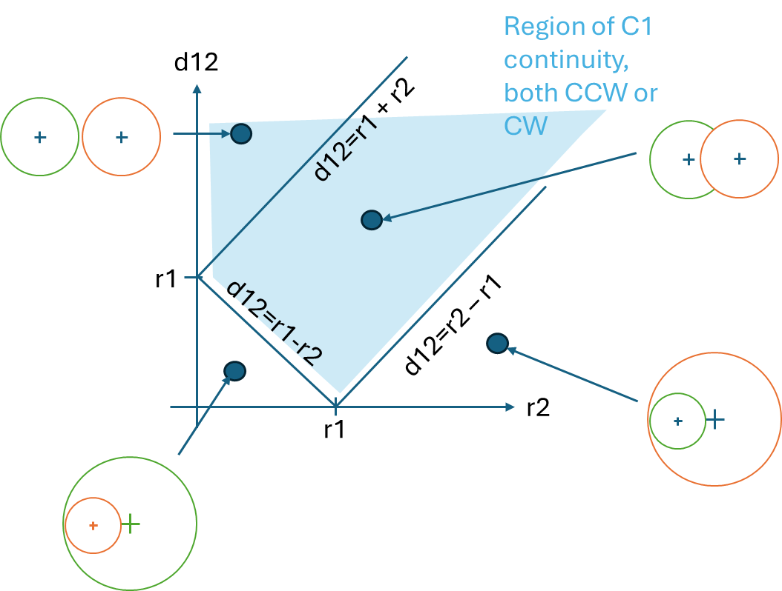
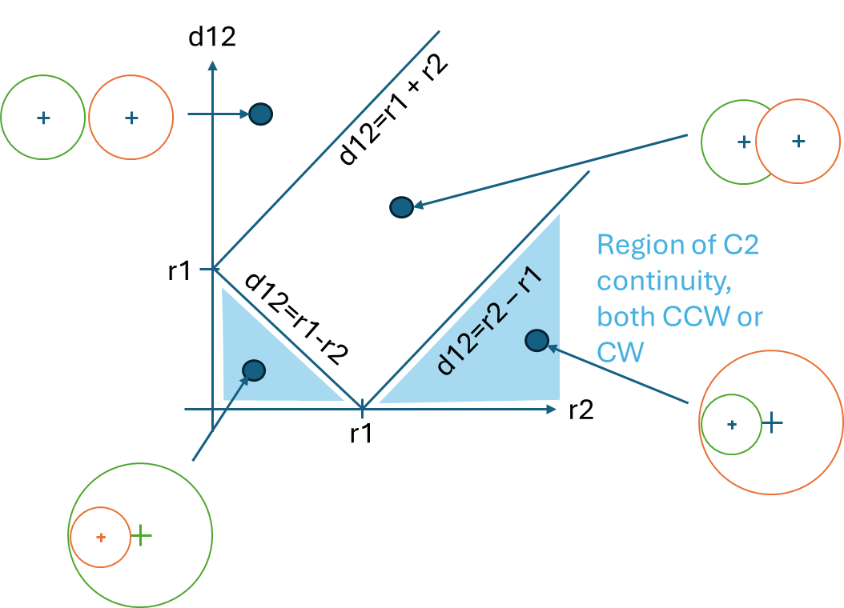
Note, of both arcs are oriented same direction, then C2 continuity covers exactly the OPPOSITE region as that for C1 continuity. Thus, for arcs to connect, they are either C1 or C2 feasible – but they cannot be both

Slide 21
Other useful metrics

Slide 22
There are often situations where 2 arcs are nearly the same, and it may be useful to measure the minimum change to merge them as 1 arc.
The distance of the query point to the [r1 0] position defines the minimum arc2 needs to change, or twice the distance that both arc1 and arc2 would change equally.
d12
d12=r1 + r2
Two arcs are almost identical (common situation)
r1
d12=r1-r2
r2
r1
Minimum change

Slide 23
Arc Curvature

Slide 24
In processing data, the curve fitting should seek to avoid breaking data mid-geometries
For example, in the test track, we want to avoid trying a start/end location in the middle of an arc, as the data before the arc may be fitted with a slightly different geometry than the data after the arc, resulting in a discontinuity. To check for loops, we check the average spacing between points and check whether the start/end points are “near” each other relative to this spacing (usually 5x average)
RAW DATA ASSESSMENT:
Number of points: 782
Spacing:
Mean spacing: 1.975 meters
Stdv spacing: 0.043 meters
Max spacing: 2.003 meters
Min spacing: 1.897 meters
Looping:
Max data distance from start: 620.054 meters
Distance from start to end: 4.521 meters
Is this data a loop? 1

Slide 25
For example, the test track is identified as a loop
RAW DATA ASSESSMENT:
Number of points: 782
Spacing:
Mean spacing: 1.975 meters
Stdv spacing: 0.043 meters
Max spacing: 2.003 meters
Min spacing: 1.897 meters
Looping:
Max data distance from start: 620.054 meters
Distance from start to end: 4.521 meters
Is this data a loop? 1

Slide 26

To simplify data processing, we wish to isolate the data fitting into data clusters such that the data fitting within one cluster does not affect adjacent clusters
Conceptually, we refer to these “fitting areas” as islands, and this notation shows up throughout the codes. In roads where curves are connected by line segments, the curves are the “islands”
Dave Hoefler, Diablo Lake / North Cascades, WA
Diablo Lake, United States
Published on July 8, 2018Canon, EOS 5D Mark III
Free to use under the Unsplash License

Slide 27

Most real-world roads are very “island”-y
Islands are where there are interconnected arcs that have no line segments within. The area between islands are line segments. Islands are useful for analysis because calculations done within an island are not affected by calculations in other islands, and so the data can be sub-grouped by island and processed island by island, thereby saving huge amounts of computation.
Ethan Rheams
Published on August 29, 2018
DJI, Mavic Pro
Free to use under the Unsplash License

Slide 28
figure(XY_fig_num);

